Slide 1

DATA ANALYSIS AND VISUALISATIONS OF INDIAN PREMIER LEAGUE
Nithin Veer Reddy | Sankaranarayanan | Mohan Dwarampudi

Slide 2
INTRODUCTION
The Indian Premier League is a professional Twenty20 cricket league in India contested during March or April and May of every year by eight teams representing eight different cities in India.In this project we want to present some cool,interesting fun facts ,records and results of IPL.
Given the amount of data collected over the years, this is a perfect scenario to do data analysis, mining. The data is structured which makes it all the more effective to perform data analysis. Due to the abundance of data, it enables us to explore the various aspects of data pipeline as well and how it can scale. This can be used in building a distributed data analysis/mining system.
A huge amount of data indicates that Data Visualizations can also be utilized to generate useful insights. This can also be used as an example of knowledge mining. It can also be used as a feedback mechanism for the players which will help them in improving the performance.
These are some of the use cases.

Slide 3
MILESTONES
Data Extraction from different sources and storing into S3.
Transforming the data into JSON Format.
Creating AWS lambda functions to parse the data before loading into DynamoDB.
Fetching geo data through Google API.
Transformed data is loaded into elasticsearch cluster.
Indexing the incoming data from lambdas with elasticsearch.
Loading the data into three different tables namely Matches,players and Deliverables.
Generate visualisations separately for each of the tables with the created indices using kibana.
Create the dashboards with the already generated visualisations.

Slide 4
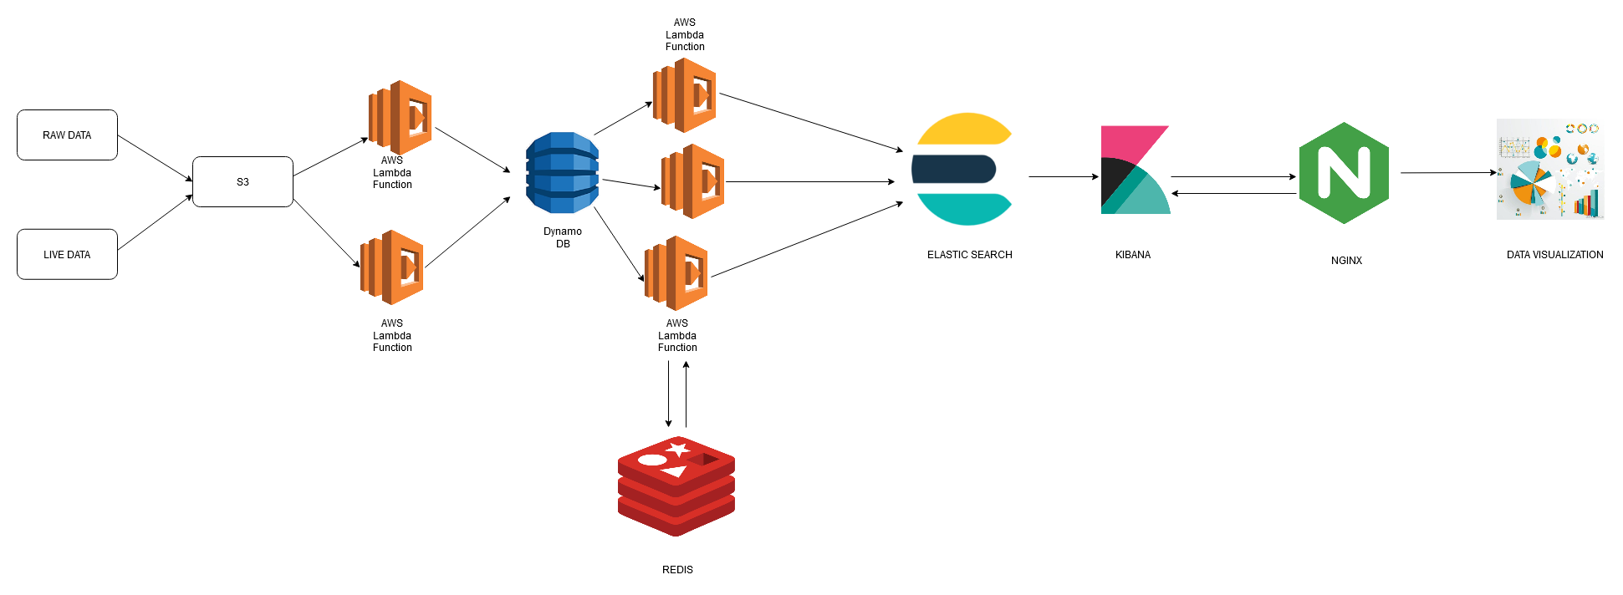
ARCHITECTURE DIAGRAM

Slide 5
INITIAL WORK
We started out by doing data extraction from sources such as Kaggle and doing preliminary data pre-processing. After this we decided to do initial analysis of data by using a few important statistically important measures like the Pearson Correlation Coefficient. This was useful in identifying the variables that are positively/negatively correlated and helped in filtering out a few columns. But this measure only works for numerical attributes. So we decided to do basic visualizations using the Python library called Seaborn. This was used in preparing a scatter plot of a pair of variables and also a heatmap of non-numerical attributes.
From the Machine Learning perspective, we decided to aggregate the data over all the seasons. This was useful in performing a preliminary K-Means analysis. Different performance metrics were used for analysis. Batsmen were classified into high performing, moderately performing players based on the number of runs scored across all the seasons. Bowlers were classified based on the number of wickets. A lot of such performance metrics can be used but could become a little tedious on large datasets. We had a large dataset that consisted of 150000 records and needed to interface with the other datasets as well. So we decided to move to ElasticSearch and Kibana which help in this purpose.

Slide 6
Issues Encountered
As the data was big, we had to ensure our data was properly indexed in ElasticSearch. Using DynamoDB to upload data to ElasticSearch took a while especially since one of our tables had 150000 records. So we had to resort to a bulk upload. Bulk upload requires the data to be a set of json objects with each object having the proper properties(index and type).
Maps Visualization were done on Kibana which required the use of GeoPoint Data Type. Kibana was not able to render the location if the latitude and longitude were represented as Decimal points.
One more common issue was that our indices were getting deleted on ElasticSearch. The exact reason was not known but based on a quick search, it was identified that databases on the public internet were prone to a ‘Meow’ attack. So we had to secure the data.

Slide 7
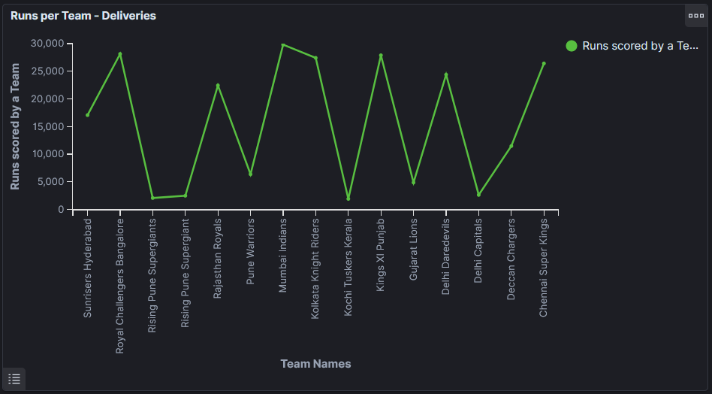
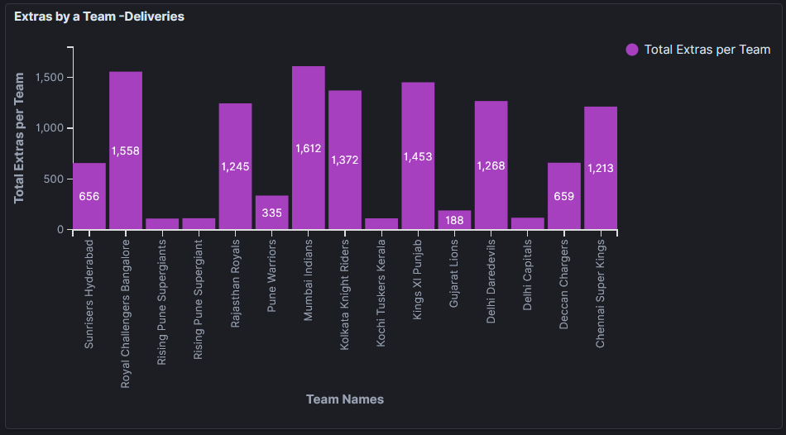
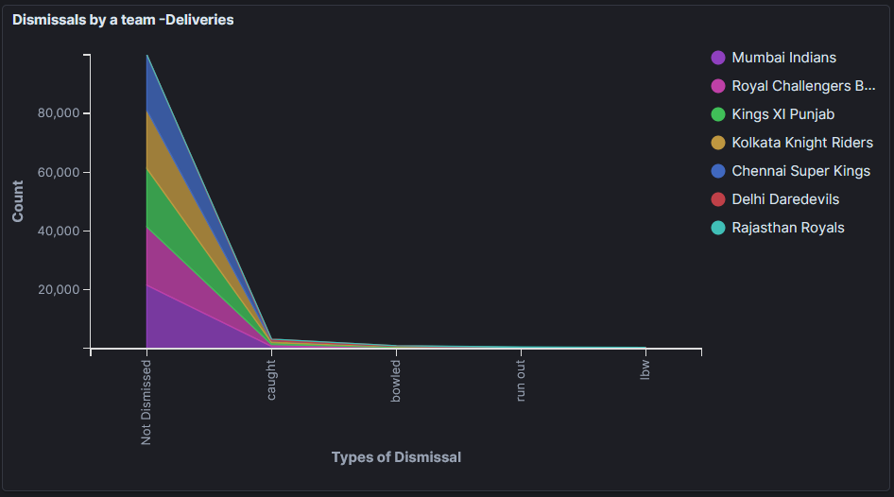
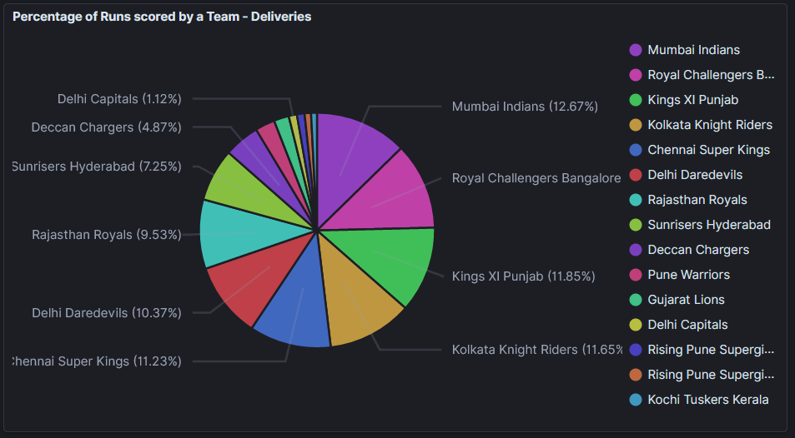
Sample Visualizations

Slide 8
THANK YOU!

